Slide 1
Welcome
VT Community Leadership Summit
August 6, 2024
Supporting Rural and Native Young People to Flourish and Communities to Thrive

Slide 2
Introductions
Kim Phinney, Co-Founder, Rural Youth Catalyst
Abby Kiesa, Deputy Director, CIRCLE

Slide 3
About CIRCLE
Nonpartisan expertise of youth civic learning and engagement:
Rigorous
Accessible
Timely
Responsive

Slide 4
Session Goals:
Introduce our Rural Youth Wellbeing Framework
Introduce CIRCLE Growing Voters Research and Framework
Think about how you can begin to use both frameworks
See how the VT Vision for Youth Success-Youth Opportunity Initiative connects to the frameworks and national work
Spark conversation and collaboration
Invite you to join us

Slide 5
Key Takeaways:
Framework is an approach not a set model
Civic participation is critical to rural youth wellbeing
Everyone plays a role in rural youth wellbeing AND within the frameworks
Collective Wellbeing = Equity
Deep systems and structural change–we all contribute at different levels
VT Vision for Youth Success findings connect directly to the frameworks

Slide 6
Small Group Conversation:
What exists in your community that makes young people feel a sense of belonging?
What makes youth feelings of belonging difficult to develop?
What supports for belonging don’t (yet) exist?

Slide 7
“How is it that we develop a theology or theologies in a 21st century capitalistic technocracy where only a few lives matter? How do we raise people up from disposability to essentiality?”-- Ruby Sales

Slide 8
Why Rural Youth Wellbeing:
Persistent Poverty
Housing and food scarcity, insecure
Extraction economies, climate impact
Education attainment, academic gaps
Civic Deserts
Mental Health Crisis-anxiety, depression, loneliness
Recruitment into extremism

Slide 9
Why Rural Youth Wellbeing:
Current Measures of Successful Transition to Adulthood
Placement in a Job
Retention for two or more quarters
Credentials/Certifications
Starting Wage
Not receiving public assistance

Slide 10
Why Rural Youth Wellbeing:
Focusing on Credential to Employer is about Economics Not Equity
in Wellbeing for Rural Youth

Slide 11
Why Rural Youth Wellbeing:
What if instead of shaping the transition to adulthood to meet the needs of employers, we shaped it to focus on lifelong wellbeing for every rural young person?

Slide 12
Why Rural Youth Wellbeing:
What if we asked young people, what does it mean to live a life well lived?
vs
What career do you see yourself doing in 30 years?

Slide 13
Why Rural Youth Wellbeing: Wellbeing as the Predictor for Long-Term Success
Our hypothesis is that focusing on holistic wellbeing throughout adolescence and young adulthood will generate healthier adults

Slide 14
Why Rural Youth Wellbeing: Our Collective Wellbeing
The wellbeing of our rural young people is inextricably linked to the wellbeing of our rural communities
and
urban communities are inextricably linked to rural communities

Slide 16
Rural Youth Catalyst Wellbeing Policy Working Group
Abby Kiesa, Deputy Director, CIRCLE, (Tisch College, Tufts University)
Abby Ritter, Youth Director, ABLE SC Independent Living Centers
Alexis Elicerio, Civic Engagement Organizer, LUPE (La Unión Del Pueblo Entero)
Amanda Bastoni Ed.D., Educational Research Scientist, CAST
Angie Koontz, School Counselor, Somonauk High School, CAST Facilitator
Carla Ocadiz, Education Equity Specialist, LUPE (La Unión Del Pueblo Entero)
Cathy Taylor, Executive Director, California Heritage YouthBuild Academy
Dana Coestar, Editor in Chief, 100 Days in Appalachia, Professor at WVU Reed College of Media, Rural Digital Youth Resiliency Project.
Geneva Wiki, Director of Belonging, Meaning, Wellbeing and Purpose, Opportunity Youth Incentive Fund, Aspen Institute
Jackie Dandenau, Executive Director, Arcata Playhouse
Jasmine Heiss, Director of In Our Backyards Initiative, Vera Institute of Justice
Joel Beeson, Ph.D., Professor at the WVU Reed College of Media, Senior Contributing Editor and Director of Research for 100 Days in Appalachia
Jordan Sophia Romero, TPACT Coordinator, Taos Pueblo Health and Community Services
Kara Johnson, Deputy Director, Heart of Oregon Corps
Mara Casey Tieken, Ed.D., Associate Professor of Education, Bates College
Melynn Schuyler, Executive Director, Santa Fe YouthWorks
Mike Hogg, Chief Operating Officer, Partners for Rural Impact
Michael Sacks, Senior Fellow, JFF (Jobs for the Future)
Paheadra Robinson J.D., Senior Policy Advisor, Children’s Defense Fund, Southern Rural Black Women’s Initiative
Rebecca Crouse Kelly, J.D., Head of Advocacy and Community Engagement, Waterford
Vanessa Bennett, Director, JFF Center for Apprenticeship and Work Based Learning

Slide 17
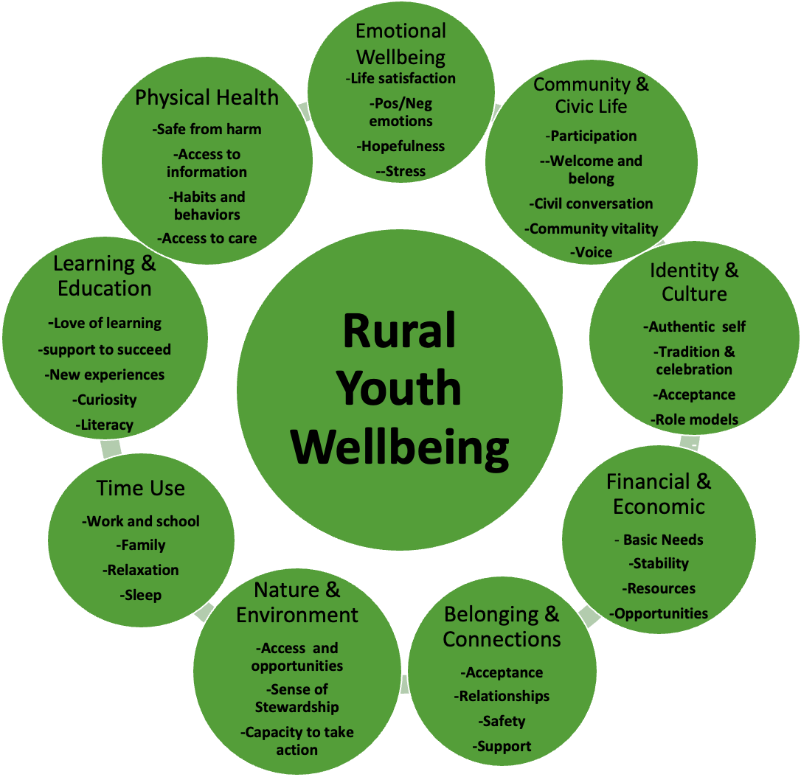

Slide 18
RYC Rural Youth Wellbeing Framework
Rural Youth Collective Wellbeing:
Individual and Systems Level
and/both

Slide 20
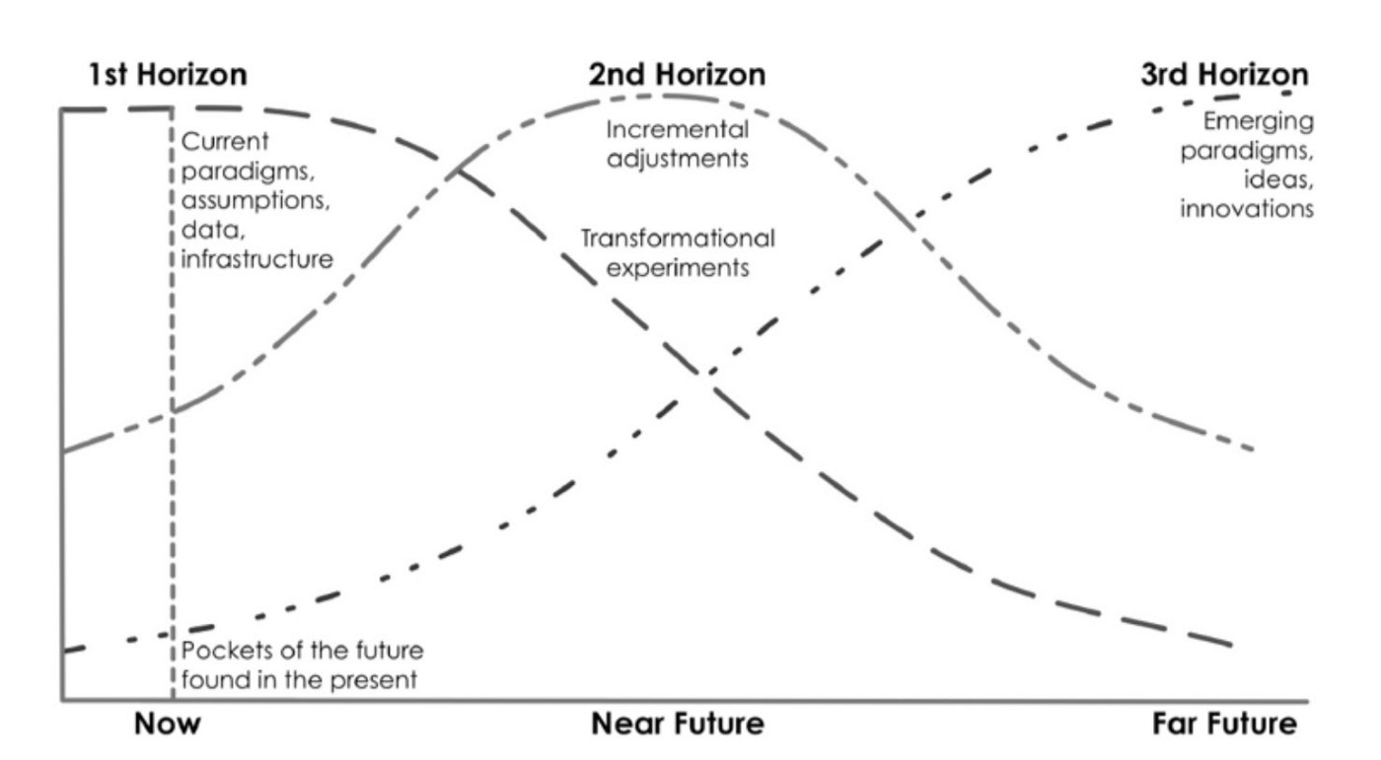

Slide 21
RYC Rural Youth Wellbeing Framework
Shape Practice and Policy:
All Staff Play A Part-no matter what domain work is focused
Program Design
Curriculum (aligns with healing centered, UDL, WBL, civic engagement, etc.)
Staff Development
Shape culture, climate of programs and schools
Build the collective wellbeing of rural youth and communities
Drive where resources and $$ get spent
Contribute to the overall wellbeing analysis within rural and urban

Slide 22
Rural Youth Catalyst
Rural Youth Wellbeing Definitions and Self-Assessment Tool
Learning & Education:
I am a lifelong learner and have adequate opportunities to increase my skills and knowledge to meet my goals.
My educational environment is supportive of my personal development.
I accept failure as an opportunity to learn.
I have opportunities for new experiences and ideas.
I have the support I need to succeed.
Community and Civic Life:
I participate in activities that support my community.
I feel welcomed and a sense of safety and belonging.
I am able to express myself, be heard, and be understood. My opinions and ideas, as well as those of others, are valued and respected in my community.
I can make a positive difference to my community life.

Slide 23
Rural Youth Catalyst
Rural Youth Wellbeing Definitions and Self-Assessment Tool
Immediate tool and agency into the hands of rural young people
Self-determine! Not adults measuring/assessing them
Not a long list of competencies that once you are proficient then you are declared “well”
Names systems that affect wellbeing and what one doesn’t have control over
Builds understanding and investment in collective wellbeing

Slide 24
Rural Youth Catalyst
Rural Youth Wellbeing Definitions and Self-Assessment Tool
Designed for and with rural youth across:
Race, youth with disabilities, LGBTQ, first generation, unhoused, undocumented, and justice involved living across the US
Deep south, Texas borderlands, central Appalachia, Pacific Northwest, Midwest, and Native Nations.
Wide range of settings including in and out of school, education/workforce training, drop-in shelters, community arts, independent living centers.

Slide 25
What is civic engagement?
Deliberative Dialogue
Informal Associations
Advocacy
and Mutual Aid
A wide range of actions and behaviors that improve communities and help solve problems
Philanthropy
Charitable Volunteerism
Community
Protests and Demonstrations
and Economic
Development
Community- Based Participatory Research
Social Entrepreneurship
Community-
Building
Voting and Formal Political Activities
Community Organizing
Adapted from the Social Change Wheel from Campus Compact Minnesota

Slide 30
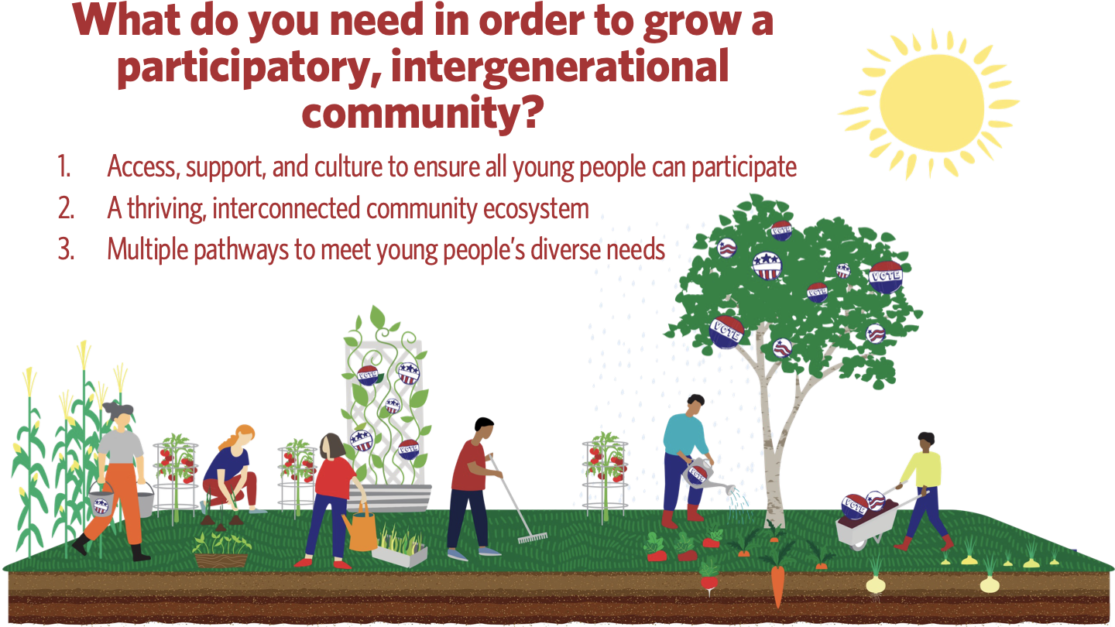
4. Collaboration and co-design with youth

Slide 38
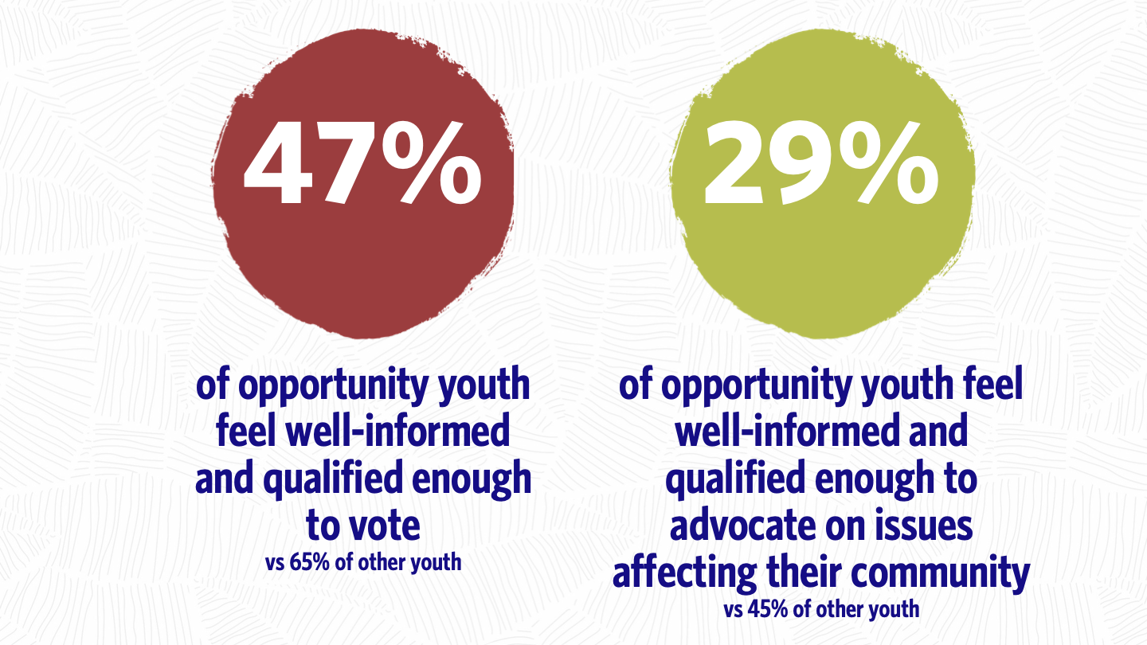

Slide 39
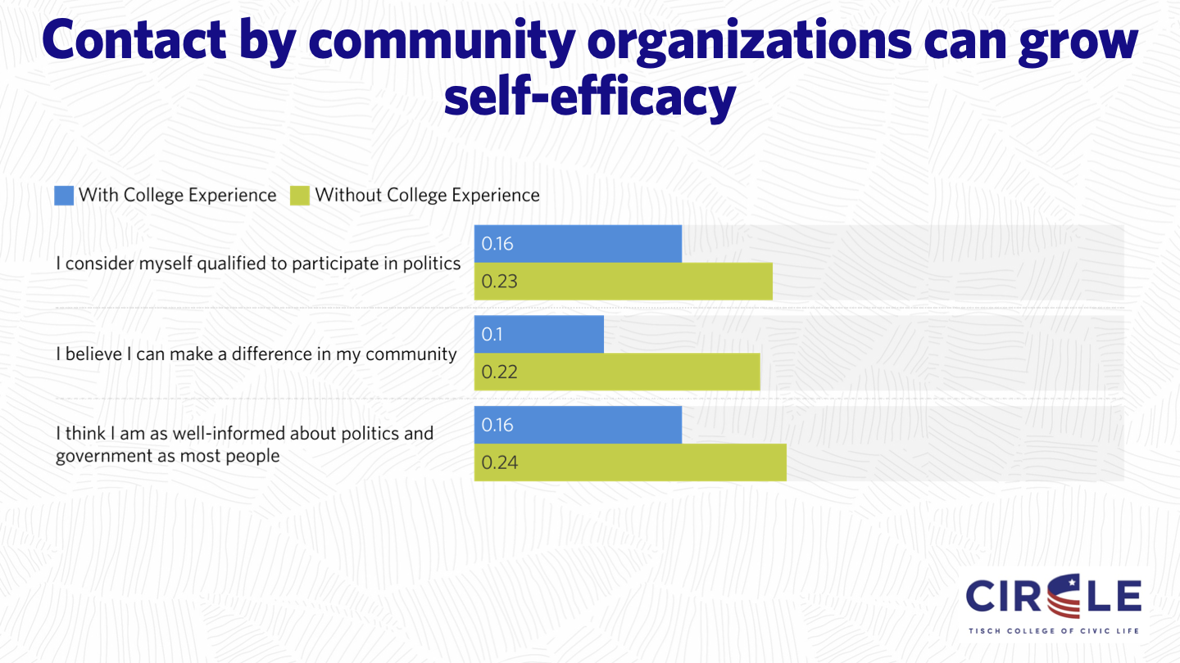

Slide 40
Conversation: Connecting Your Work to Wellbeing
Why is it important to think about all of these domains together?
Why is it helpful to connect civic and community life to the other 8 domains? How does it change how you think about your work?
How do you see these frameworks connected to the VT Vision for Youth Success findings?
Think about what you talked about at the beginning-about what helps and hinders belonging–is there anything from these frameworks that helps you think about that differently?

Slide 41
Collaborate with Us:
Kim Phinney =kphinney@ruralyouthcatalyst.org
Abby Kiesa = abby.kiesa@tufts.edu
www.ruralyouthcatalyst.org
https://circle.tufts.edu/

